Slide 1

CTFd
Capture The Flag framework (Ci/CD)

Slide 2
Content
1: Introduction
2: Secret scan
3: Python safety
4: Pyraider
5: Bandit
6: Build
7: Container scan
8: ZAP
9: SUMMARY

Slide 3
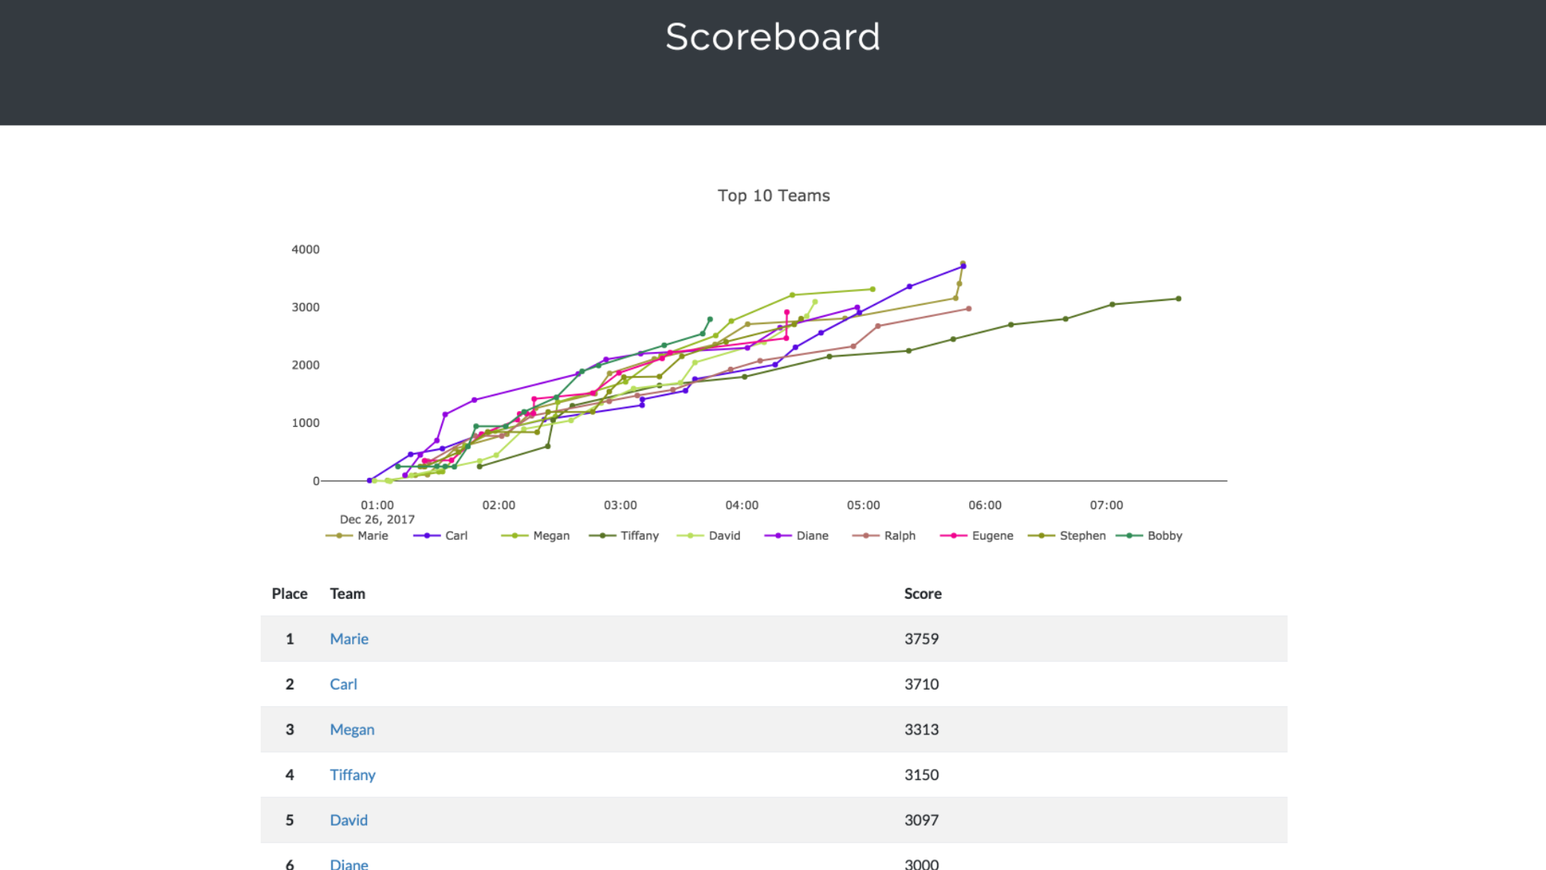
WHat is ctfd?
CTFd is a Capture The Flag framework focusing on ease of use and customizability. It comes with everything you need to run a CTF event and it's easy to customize with plugins and themes.

Slide 4
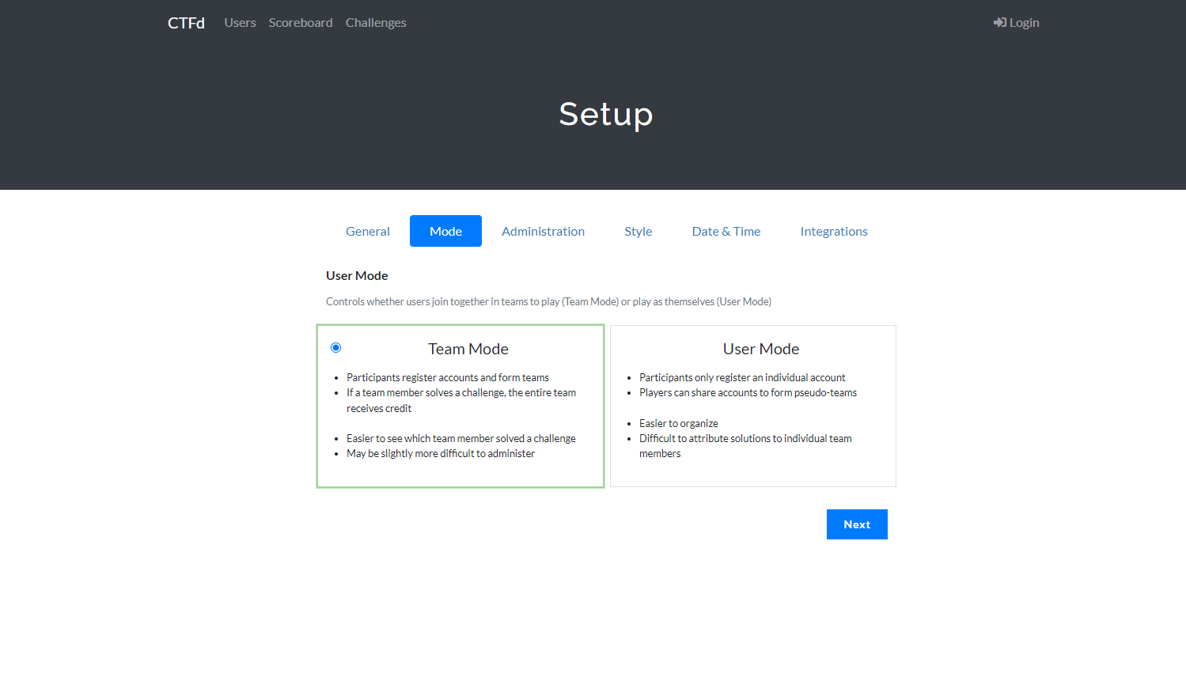
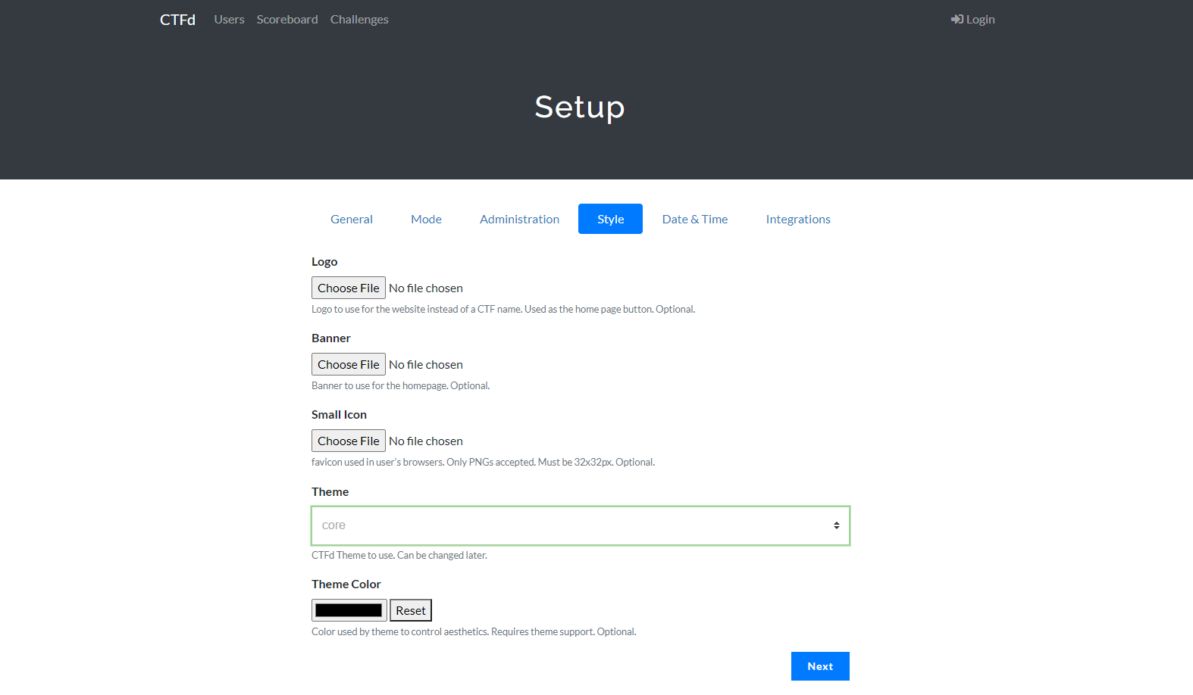
functionalities
The open-source web app offers certain functionalities for user customization such as logos, banner, date & time settings, and the option to choose between Team and User mode.

Slide 5
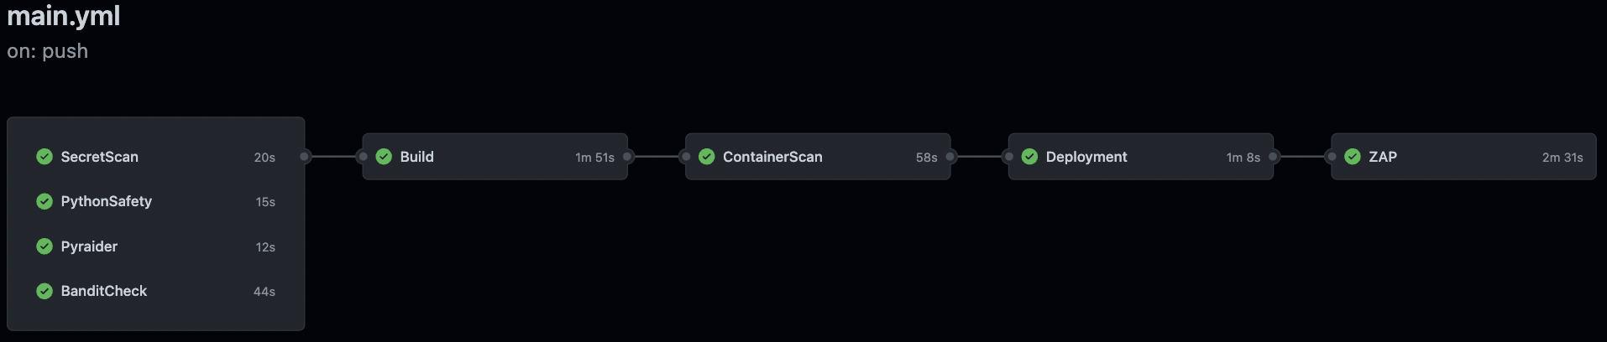
Devops → devsecops

Slide 6
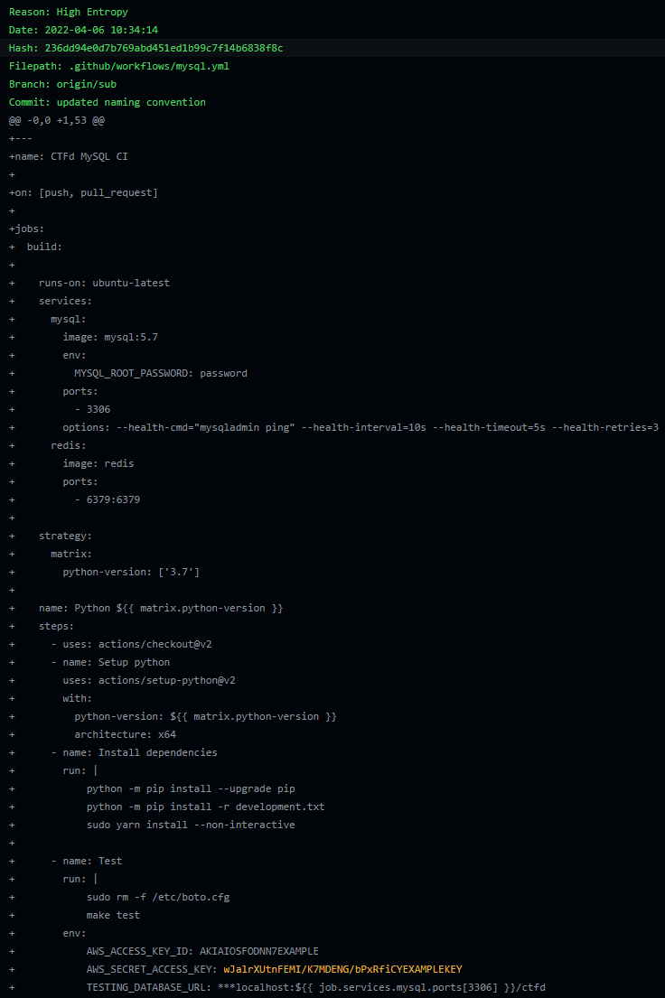
1 real issue with multiple false positives
AWS_SECRET_ACCESS_KEY value hardcoded instead of using repository secrets
Because the scan detects for high entropy, any random string that looks like a hash value or secret will be reported and there are many of these!
Secret Scan

Slide 7
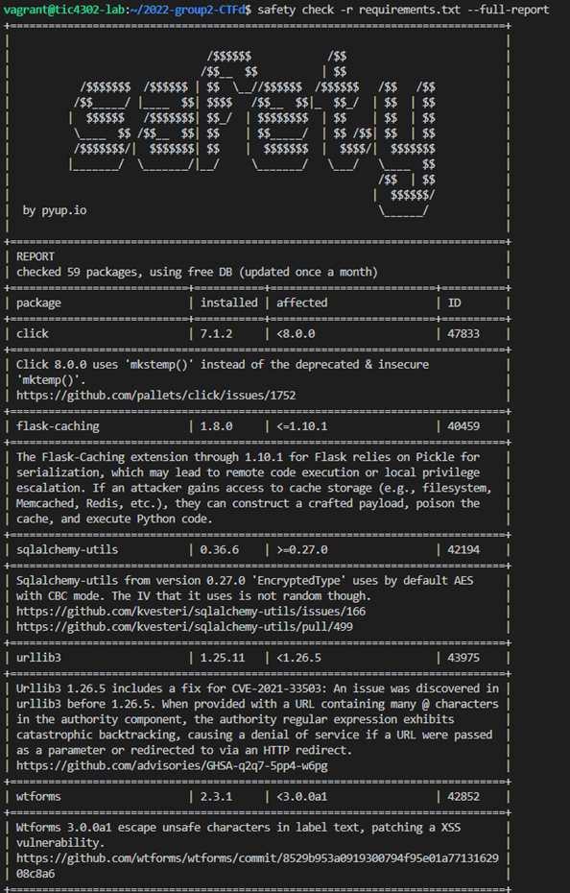
59 dependency packages checked, 5 issues reported
RCE, LPE, DOS, and XSS among many vulnerabilities
Fixed with version upgrades
Python Safety Check

Slide 8


Python Safety Check – Issues faced
Latest version is still vulnerable
Version past a certain point is vulnerable. Do we want to rollback so far?
Packages dependent upon one another (59 packages!)

Slide 9
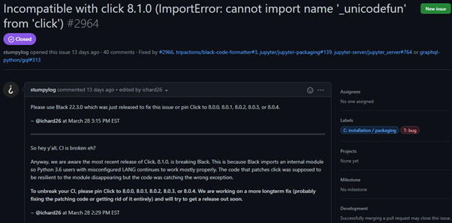
Python Safety Check – Issues faced (cont)
Latest version is buggy/unusable. Which version between current and latest should we use? Which is compatible with the other packages?

Slide 10

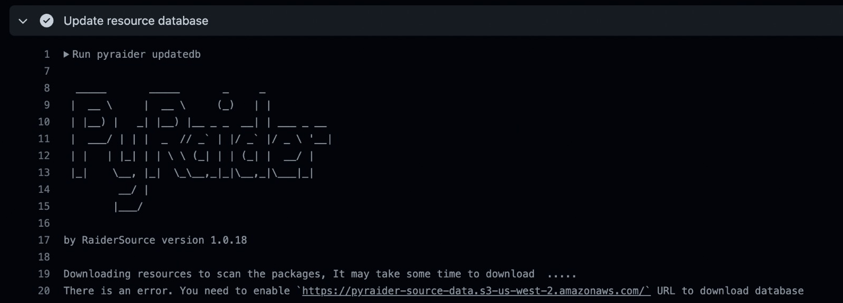
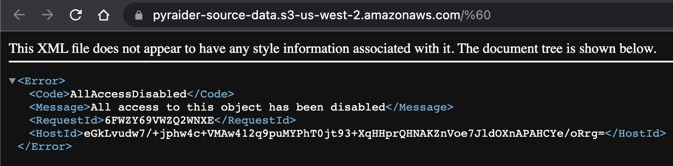
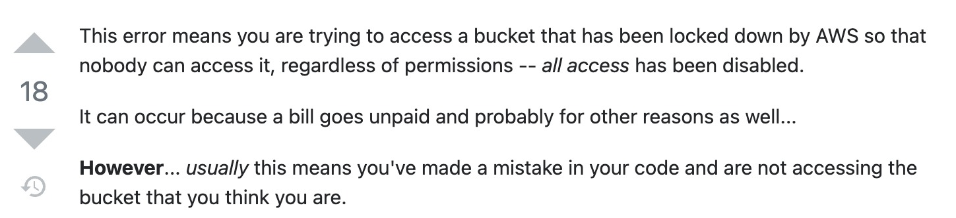
pyraider

Slide 11
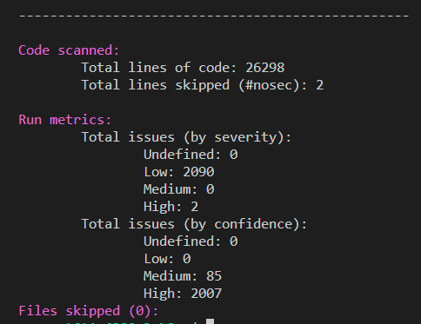
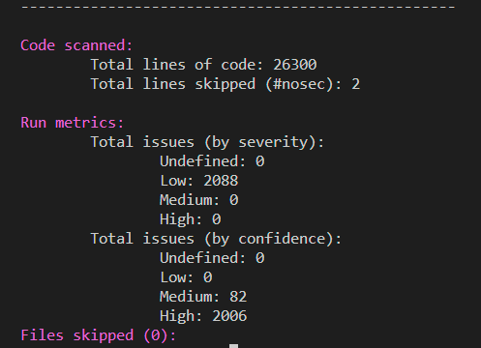
Bandit
Bandit Scan before fix:
Bandit Scan after fix:
2 Low and 2 High issues resolved

Slide 12
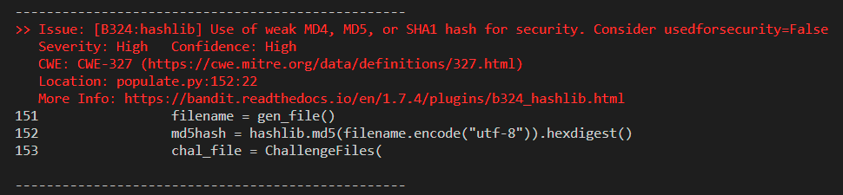
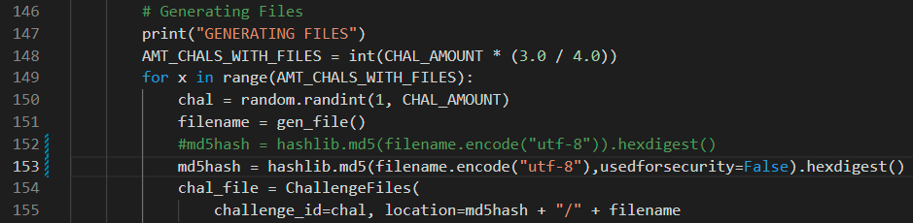
Bandit
2 High level issues
1st issue:
Fix:

Slide 13
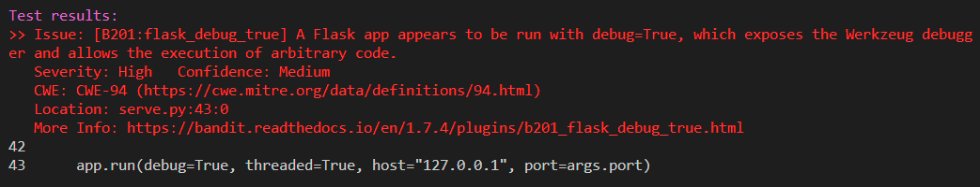
Bandit
2 High level issues
2nd issue:
Fix:

Slide 14
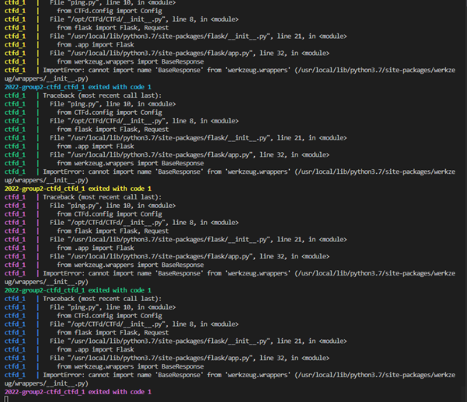
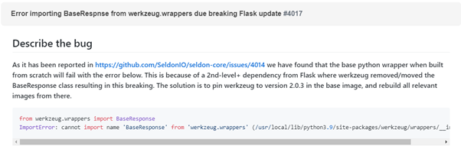
Build
Errors from upgrading packages in requirements.txt
Many reasons such as library name changes and incompatibility
Resolve through issues one by one, frequently requiring rollback to older version.

Slide 15
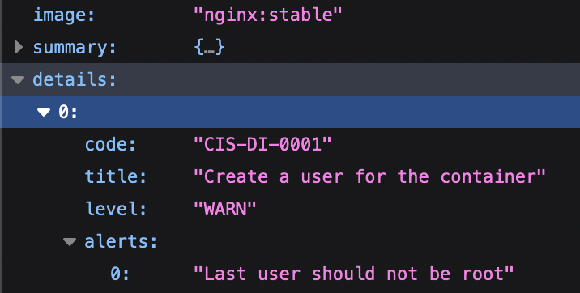
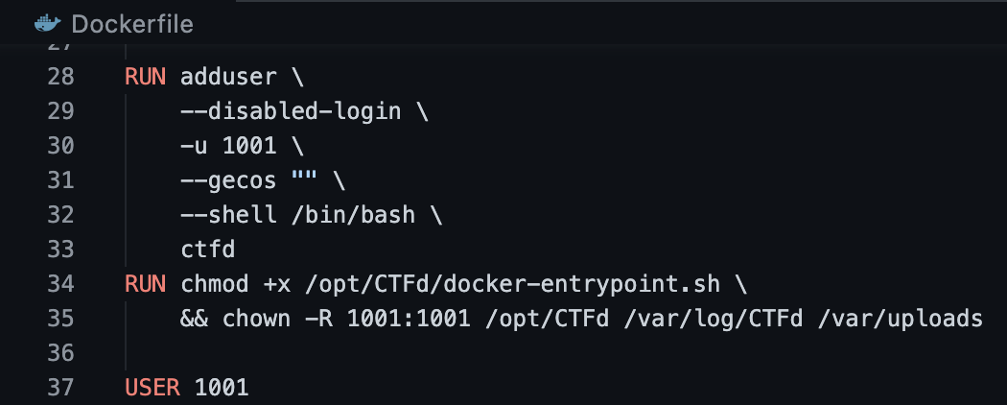
Dockle Scan (false positive?):
Container Scan
Dockle scan for image linting to check for best practices and against CIS benchmarks
False-positive warnings even though non-root user already present

Slide 16
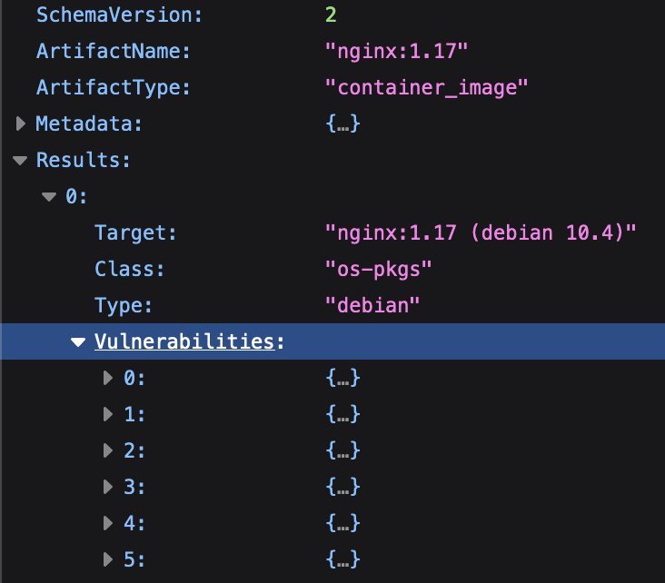
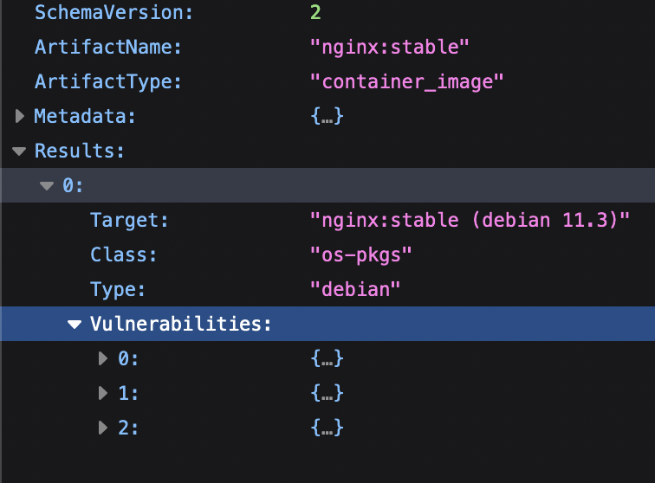
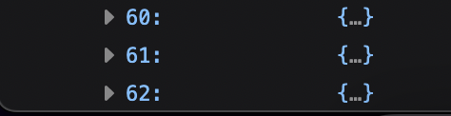
Container scan
Trivy Scan before fix:
Trivy Scan after fix:
Trivy scan for scanning of vulnerabilities in container images, file systems, Git repositories, and configurations
Massive improvement to vulnerability counts after upgrading to a recent version of Nginx
. . .
.
Before fix, there are 62 vulnerabilities due to the old version of Nginx image being used. After changing to use a more recent version, the number of vulnerabilities is reduced to only 3.

Slide 17
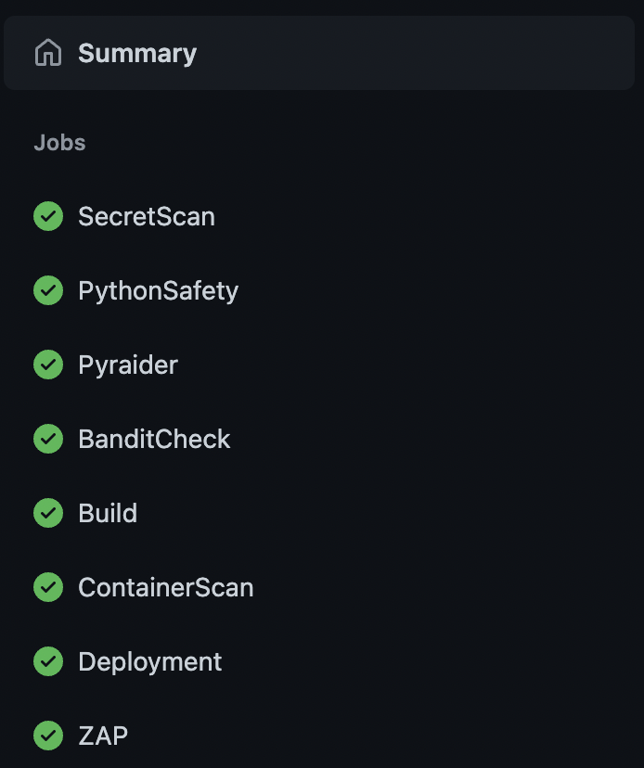
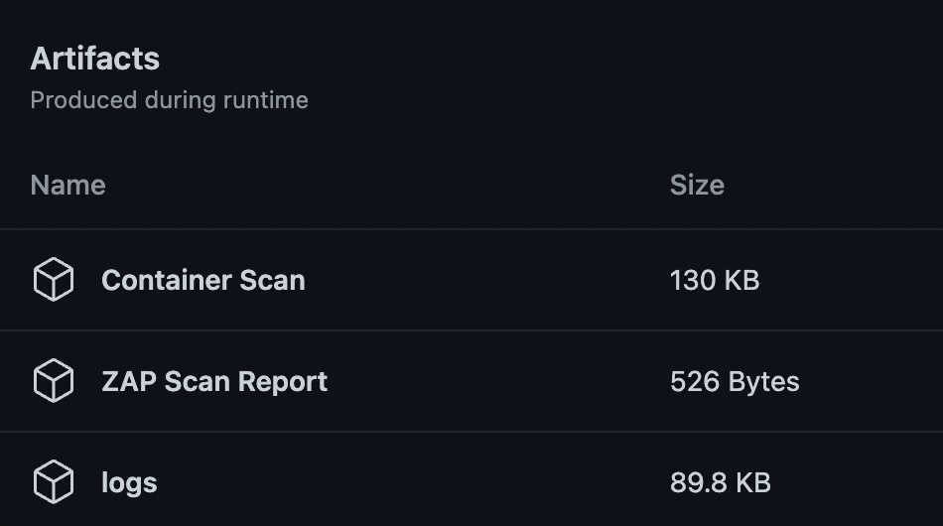
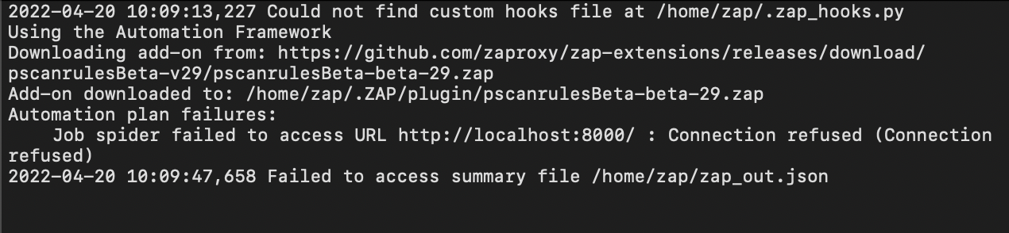
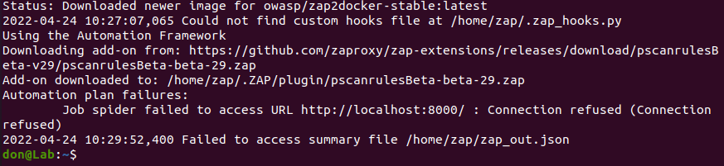
ZAP on GitHub Workflow:
ZAP
ZAP scan completes without error, but it is unable to establish a connection to the app so there are no scan results
Same outcome when tested on VM locally, using unedited source codes directly from original repo
ZAP on local VM:

Slide 18
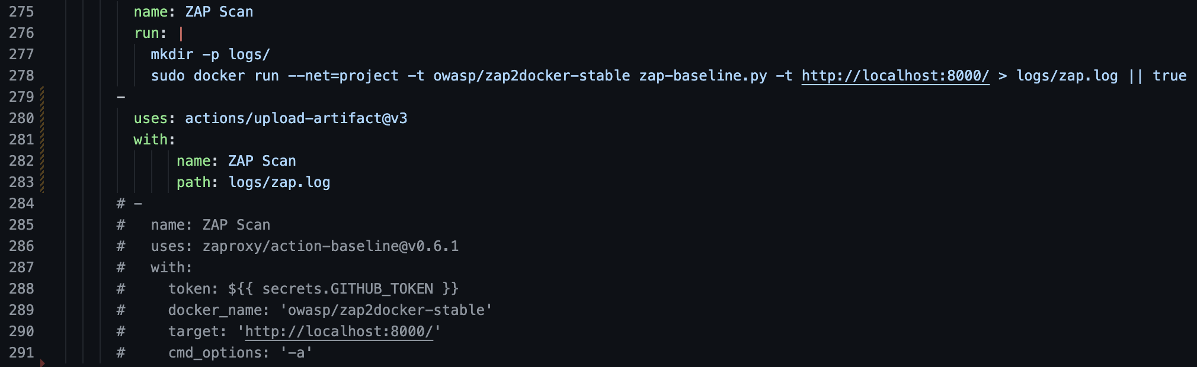
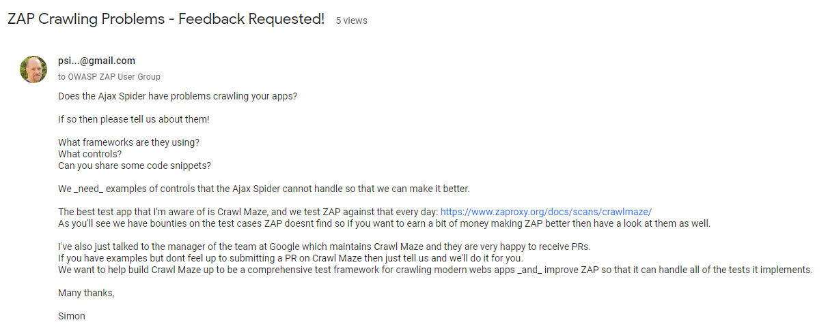
Tried different methods of ZAP – both CLI-style and GitHub actions
Also tried different configuration combinations. E.g., different domain, port, created networks to group the various containers, etc.
ZAP
Most probably due to nature of app, app misconfiguration from the start, or incompatibility with ZAP
Probably requires massive amendments to the app for it to work as intended

Slide 19
Summary
Learnt a lot. Good experience in building our own CI/CD pipeline from scratch although faced with many issues. Helps to crystalize contents and learnings from classes via hands on.
Looks easy but in fact its non-trivial. It is very complicated as the app was designed and built with rather old software versions. A lot of dependencies breaks when we try to upgrade one piece of software. Quite restricted due to application’s architectural design.
App’s configuration leads to complications in generating the workflow. E.g., ZAP not able to work

